Slide 1

How F# Learned to Stop Worrying and Love the Data
Tomas Petricek
tomas@tomasp.net | @tomaspetricek
PhD Student at University of Cambridge
& Coordinator of http://fsharp.org

Slide 2


Tomas Petricek
Real World Functional Programming
tutorials F# and C# monads functional concepts practical examples
F# Deep Dives
industry experts . domain modeling financial & insurance web & data actor model concurrency social gaming
F# Trainings & Consulting
testing London async & concurrent New York DSLs data processing http://functional-programming.net

Slide 3
software stacks trainings teaching F# user groups snippets mac and linux cross-platform books and tutorials
F# Software Foundation
F# community open-source MonoDevelop
http://www.fsharp.org
contributions research support consultancy mailing list

Slide 4

The Data

Slide 5

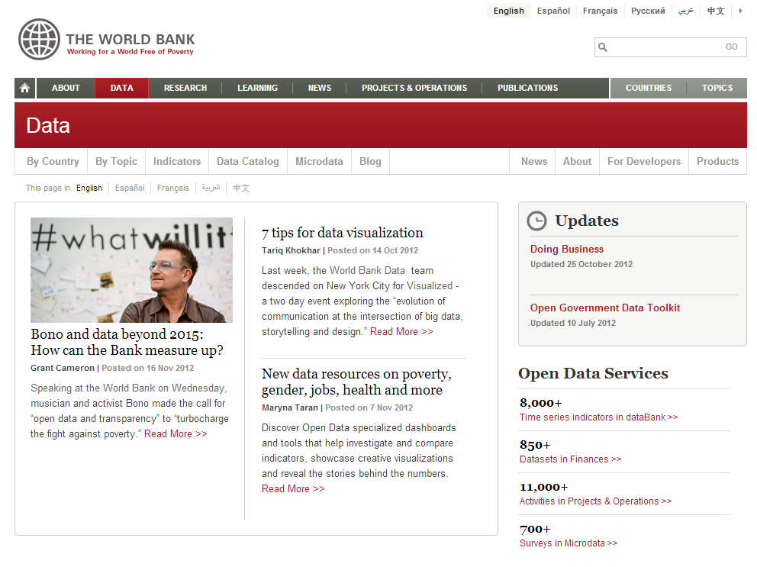
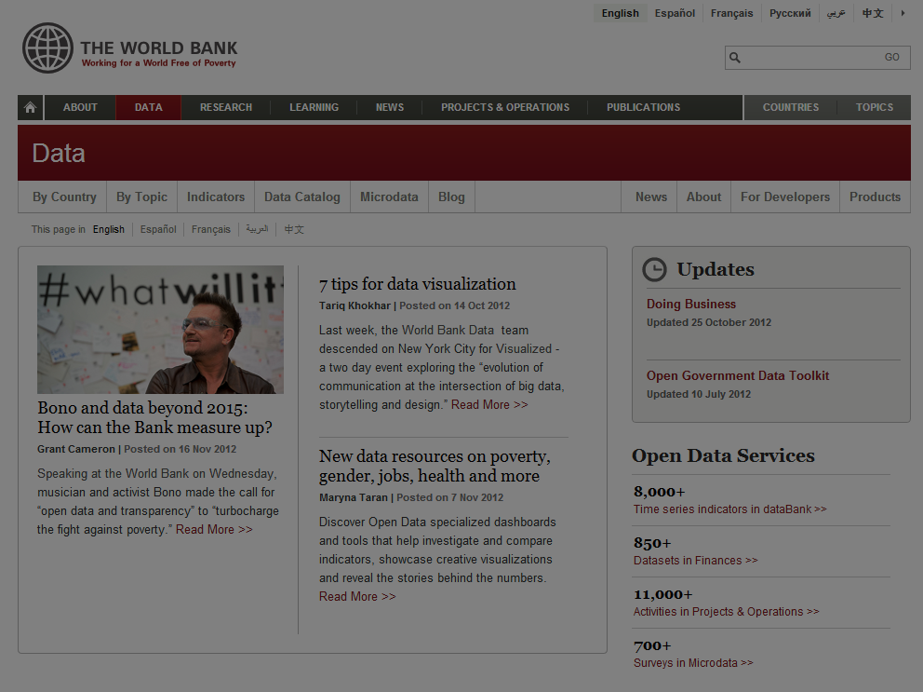

Slide 6
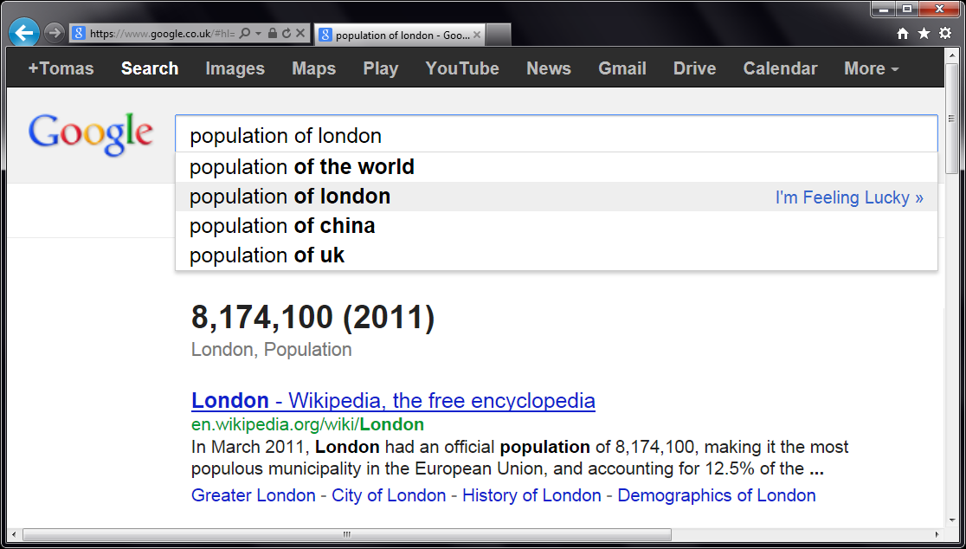
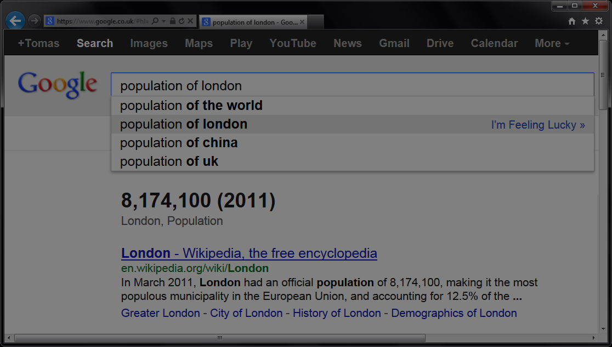


Slide 7
let wb = WorldBank()
w
b
.

Slide 8
Demo summary
Try F# web site
Play with F# and read great tutorials
http://tryfsharp.org
F# Data Library
Type providers for WorldBank, JSON and more
http://github.com/tpetricek/FSharp.Data

Slide 9
F# to JavaScript

Slide 10
Demo summary
FunScript with TypeScript provider
Import types for JavaScript libraries
http://github.com/ZachBray/FunScript
Web programming using F#
IntelliFactory WebSharper and many other
http://fsharp.org/webstacks

Slide 11
Accessing REST services
REST (Representational State Transfer) is a style of software architecture for distributed systems such as the World Wide Web. REST has emerged as a predominant Web service design model.

Slide 12
F# type provider for JSON

Slide 13
Demo summary
Structural type providers
Infer type from sample XML, CSV or JSON
http://github.com/tpetricek/FSharp.Data
Calling REST API
Static type safety without schema
Many APIs follow similar patterns…

Slide 14
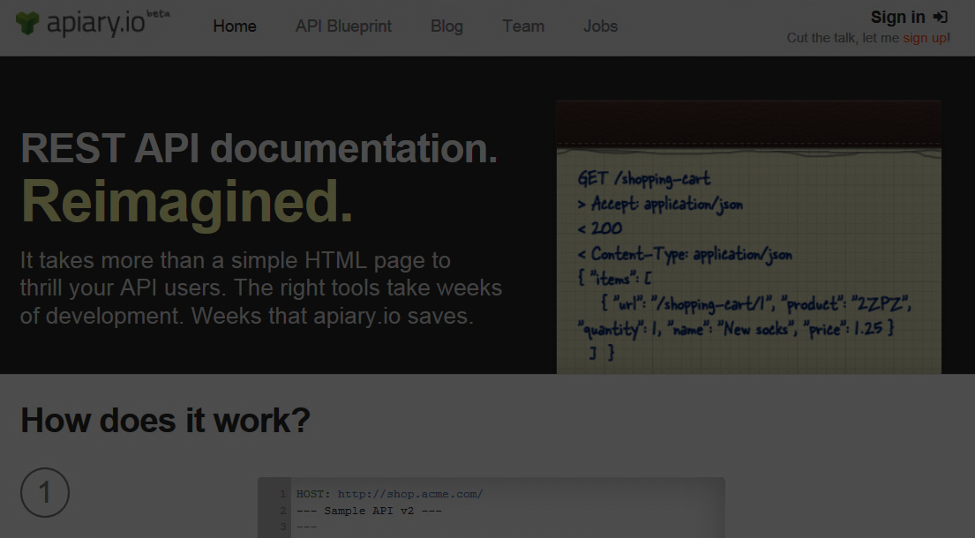
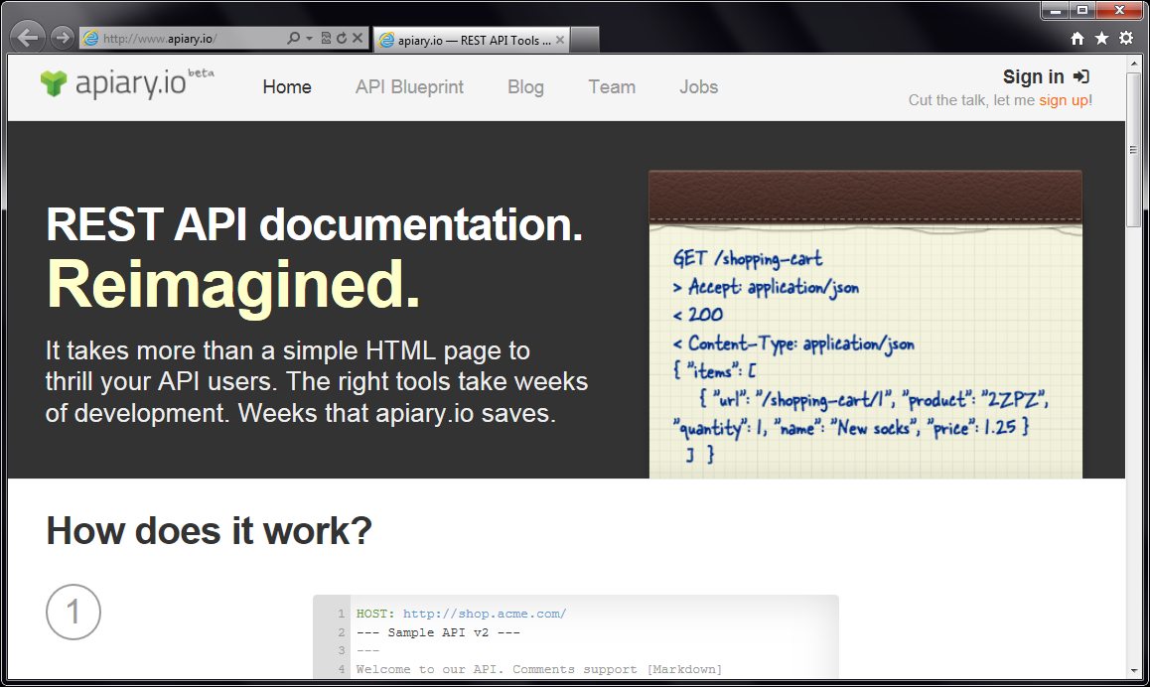
Accessing REST services

Slide 15
Apiary.io Type Provider
Common REST conventions
GET /movie/{id} Get movie summary
GET /movie/{id}/casts Get cast details
Types from JSON samples
{ "page": 1, "results": [ { "title": "Skyfall", "id": 94221 } ] }

Slide 16
Apiary provider in JavaScript

Slide 17
Summary

Slide 18
F#
JSON
unstructured data XML and CSV .
Open Government Data custom providers Language Integration
Excel static types .
web services R provider unstructured data
documentation schema
REST API web programming
WorldBank TypeScript
Apiary

Slide 19
For more information…
Learn and explore F#
Read tutorials at http://tryfsharp.org
Join local and online community
User groups and lists at http://fsharp.org
Trainings and tutorials
Upcoming in London & New York
Check out http://functional-programming.net

